Slide 1
Data Visualization
MORS CSAP
Tuesday, March 11, 2025
Walt DeGrange

Slide 2
Agenda
Selecting Graphics
Instruction
Creating Graphics in Excel
Instruction
Guided practice / check for understanding
Independent Practice & Assessment
Critique
Guided practice / check for understanding

Slide 3
Selecting a graphic – considerations
What story do you want to tell?
Who is the audience?
What types of data and limitations are you working with?

Slide 4
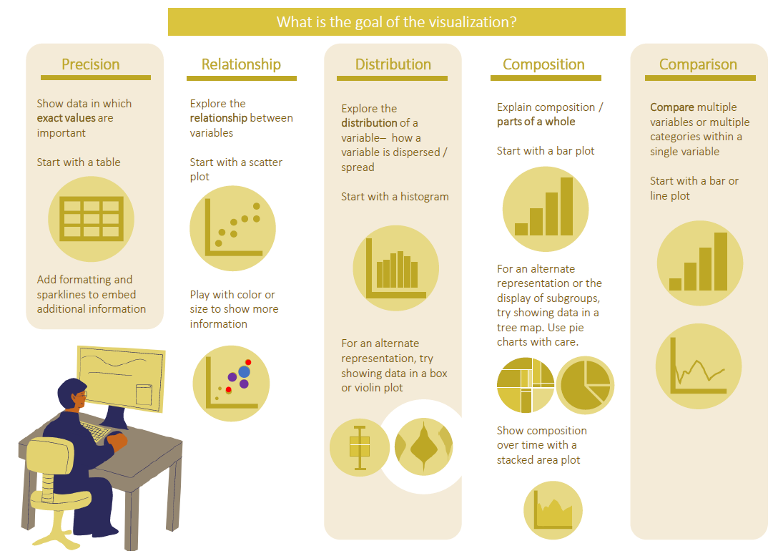

Slide 5
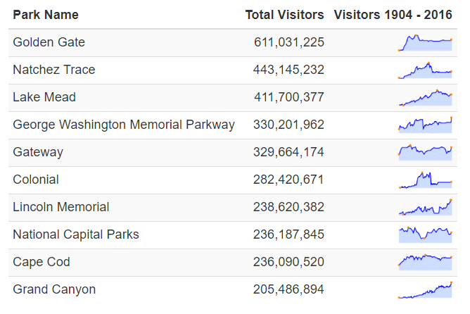
Precision
Top Ten Most Visited National Parks
Exact values and underlying data are important
Diverse audience – each viewer may want to explore different facets of data in detail

Slide 6
Precision – Tables
Top Ten Most Visited National Parks
Do:
Format! Apply color, font, and sparklines to help the user interpret data quickly
Don’t:
Skip comparison to other graphic representations. Make sure tables are used with care

Slide 7
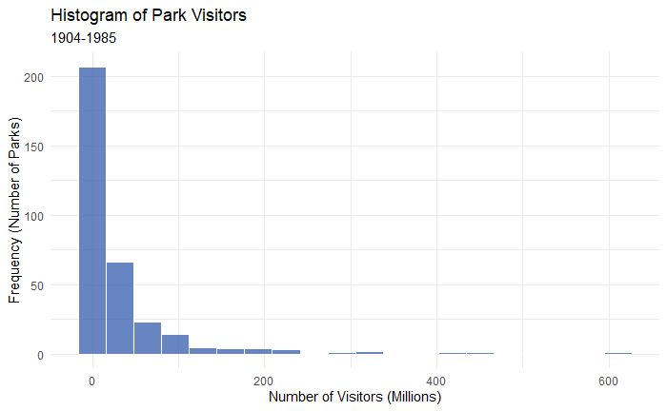
Distribution
Explore the frequency distribution (shape) of a set of continuous data
For one field, use a histogram
To provide more information, try a box or violin plot

Slide 8
Distribution – Histogram
Do:
Select the bin size to best show the shape of the data
Don’t:
Create bins of different sizes
Notes:
Discuss both frequency distributions and probability distributions here.

Slide 9
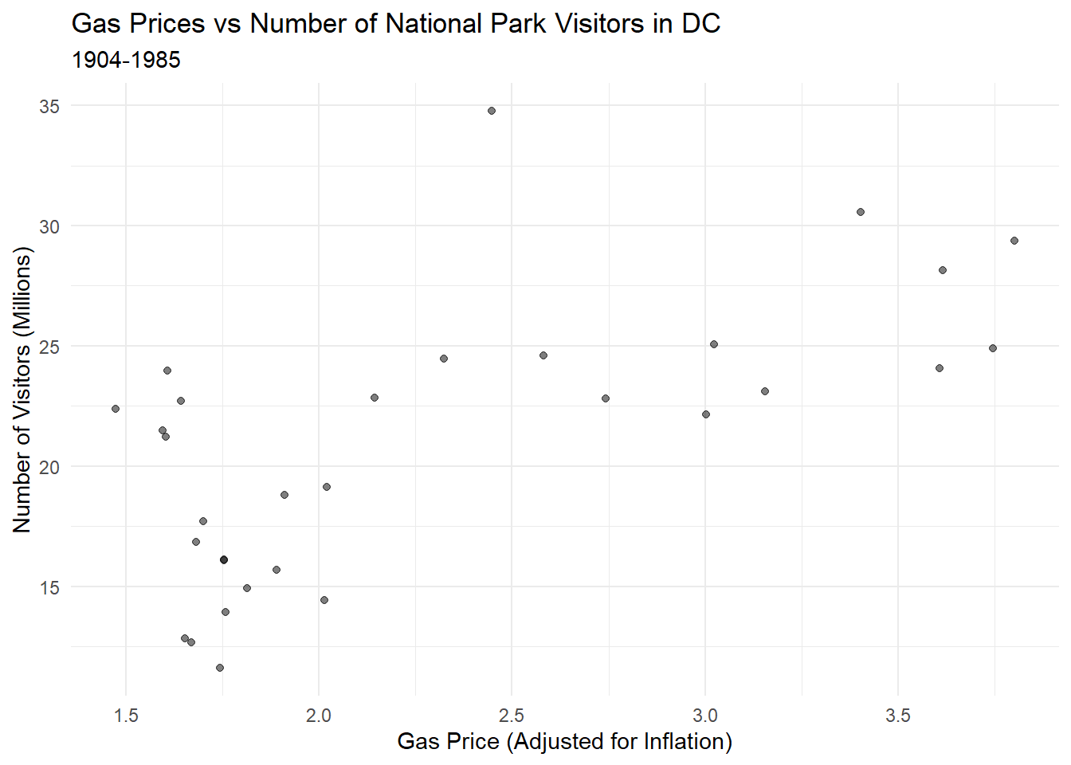
Relationship
Show relationship between numerical variables
Notes:
Discuss categorical vs numerical variables here.

Slide 10
Relationship – Scatter Plot
Do:
Use to plot relationship between numerical variables
Don’t:
Use a single scatterplot for three or more variables → Use multiple scatterplots instead
Notes:
Talk about how the number of scatterplots expands exponentially as the number of variables being explored is increased.

Slide 11
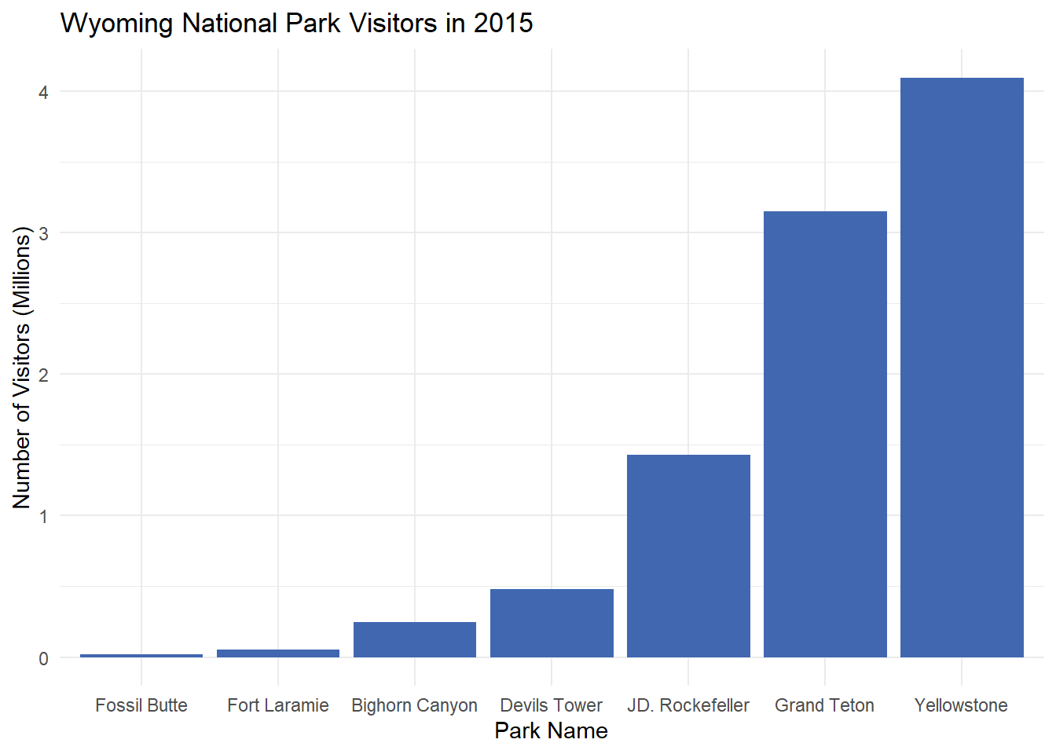
Comparison
Perform a comparison among items or over time
Bar plots and line charts are useful comparison tools

Slide 12
Comparison – Bar Plot
Do:
Use to present comparisons of categorical data
Don’t:
Use to present relationships between numerical data
Notes:
Talk about when you would use a bar chart vas a scatterplot

Slide 13
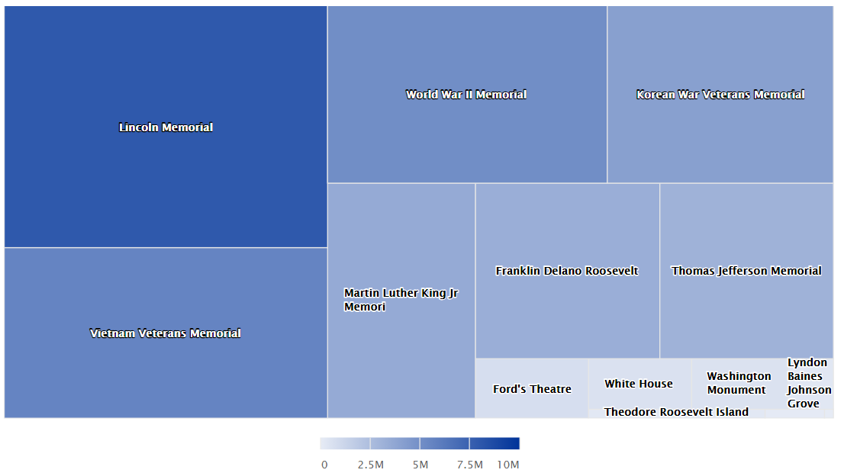
Composition
DC Park Visits in 2015
Parts of a whole
Visuals to consider:
Pie Charts
Tree Maps
Area Charts

Slide 14
Composition – Tree Map
DC Park Visits in 2015
Do:
Use tree maps for static data
Use color to represent groups and subgroups
Don’t:
Use with data with many categories
Notes:
Talk about why pie charts are not to be used here.

Slide 15
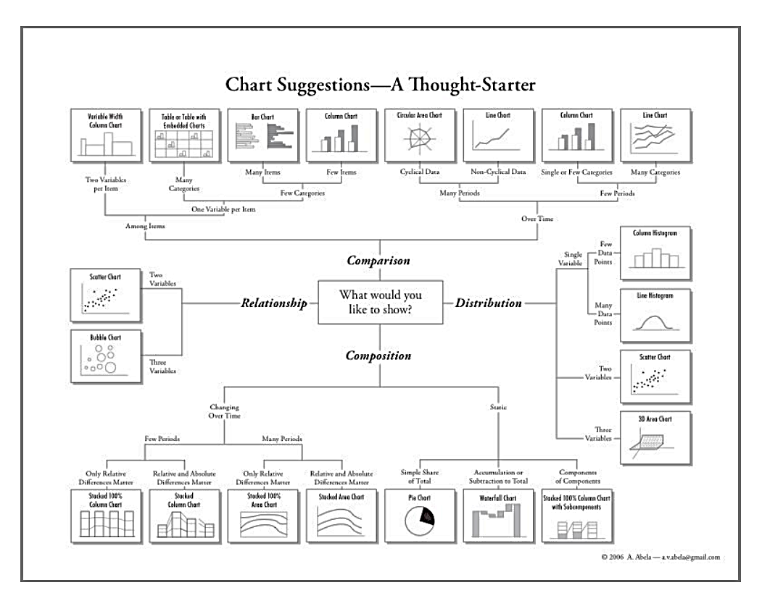
Selecting a graphic
We looked a just a few examples today. There are many more graphics to explore!
Notes:
Talk about why pie charts are not to be used here.

Slide 16
History of Data Visualization

Slide 17
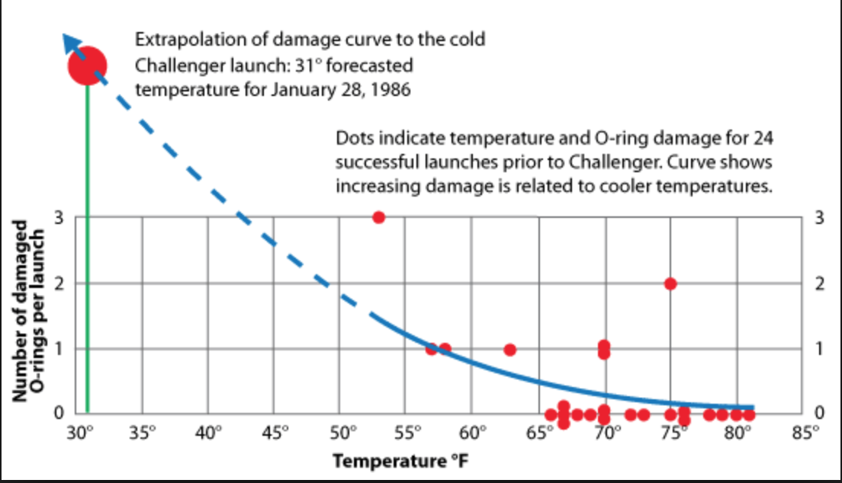

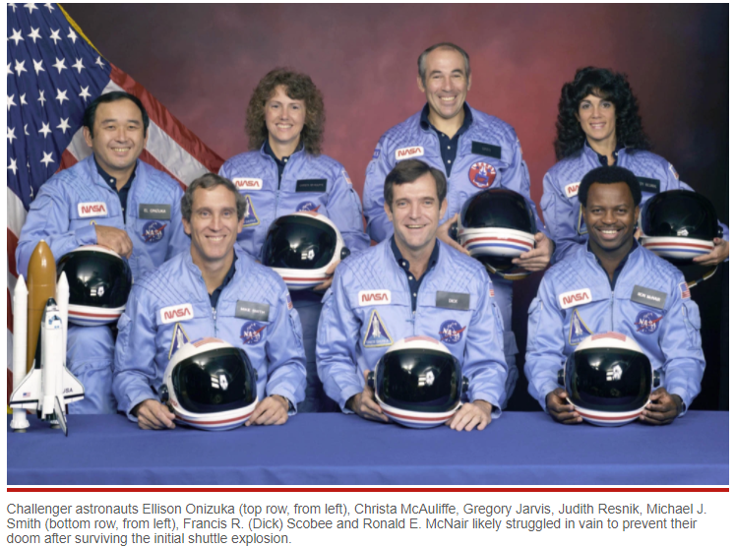
1986 - Rogers Commission Report

Slide 18



Putting Data in Context and Supporting Decisions
First Minister of State (1661-1683)
Comptroller-General of Finances (1665-1683)
Secretary of state of the navy (1668-1683)

Slide 19

1869 - Charles Joseph Minard

Slide 20
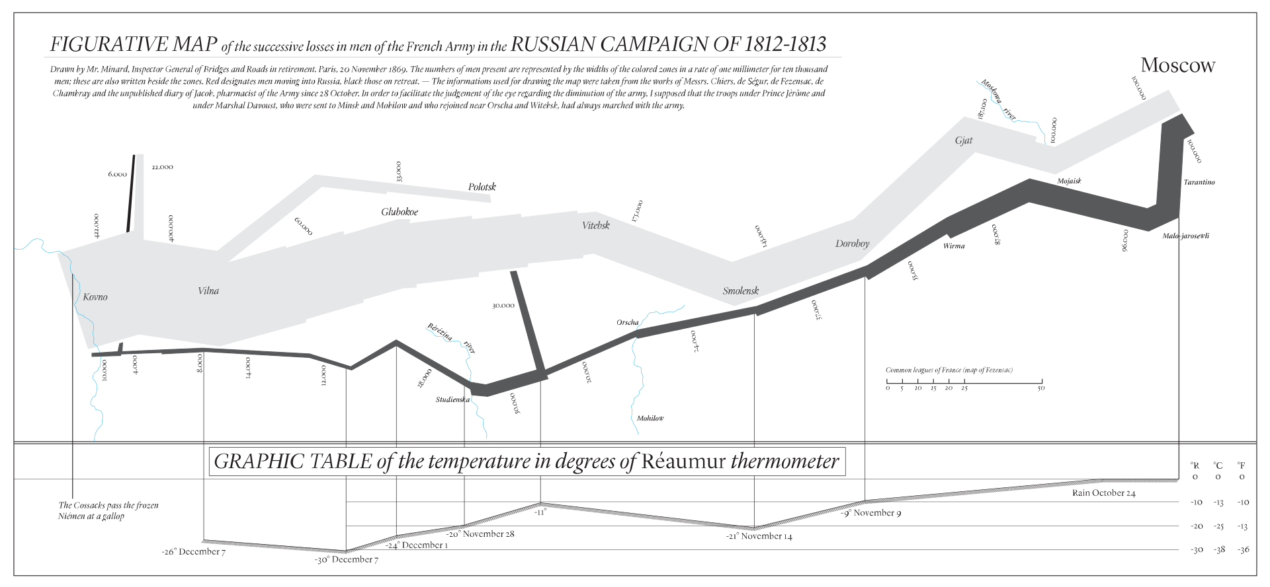

Slide 21
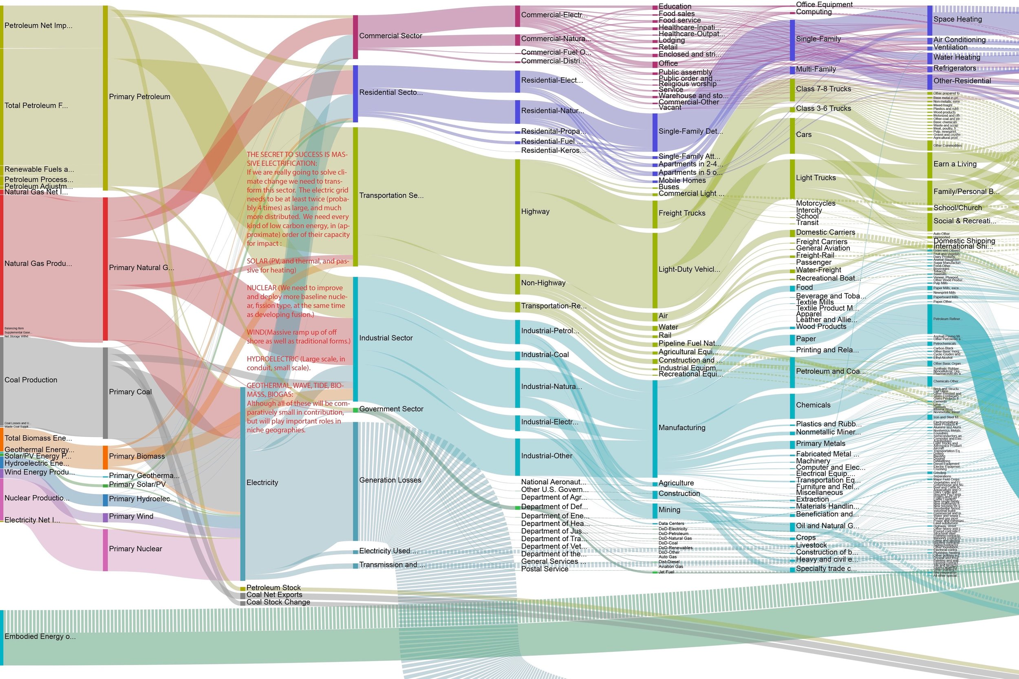
https://www.otherlab.com/blog-posts/us-energy-flow-super-sankey

Slide 22
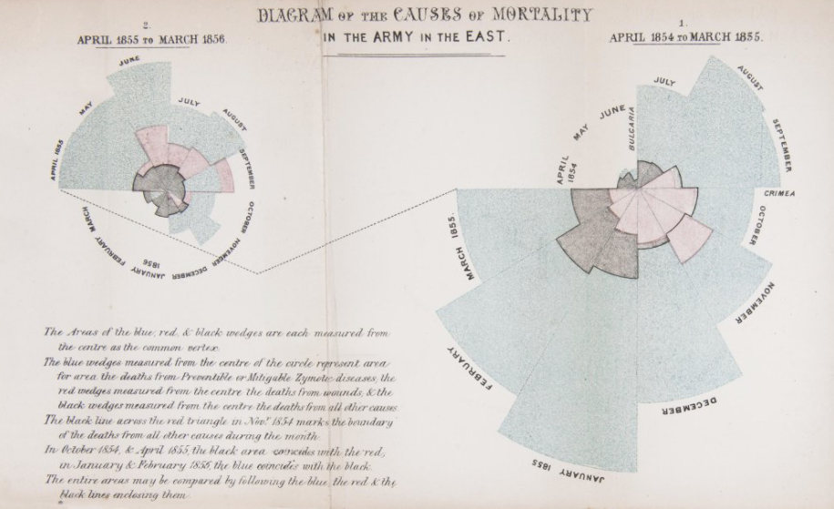
Science Museum. “Florence Nightingale: The Pioneer Statistician.” Accessed October 20, 2021.
https://www.sciencemuseum.org.uk/objects-and-stories/florence-nightingale-pioneer-statistician.

Slide 23

1858 - John Snow

Slide 24
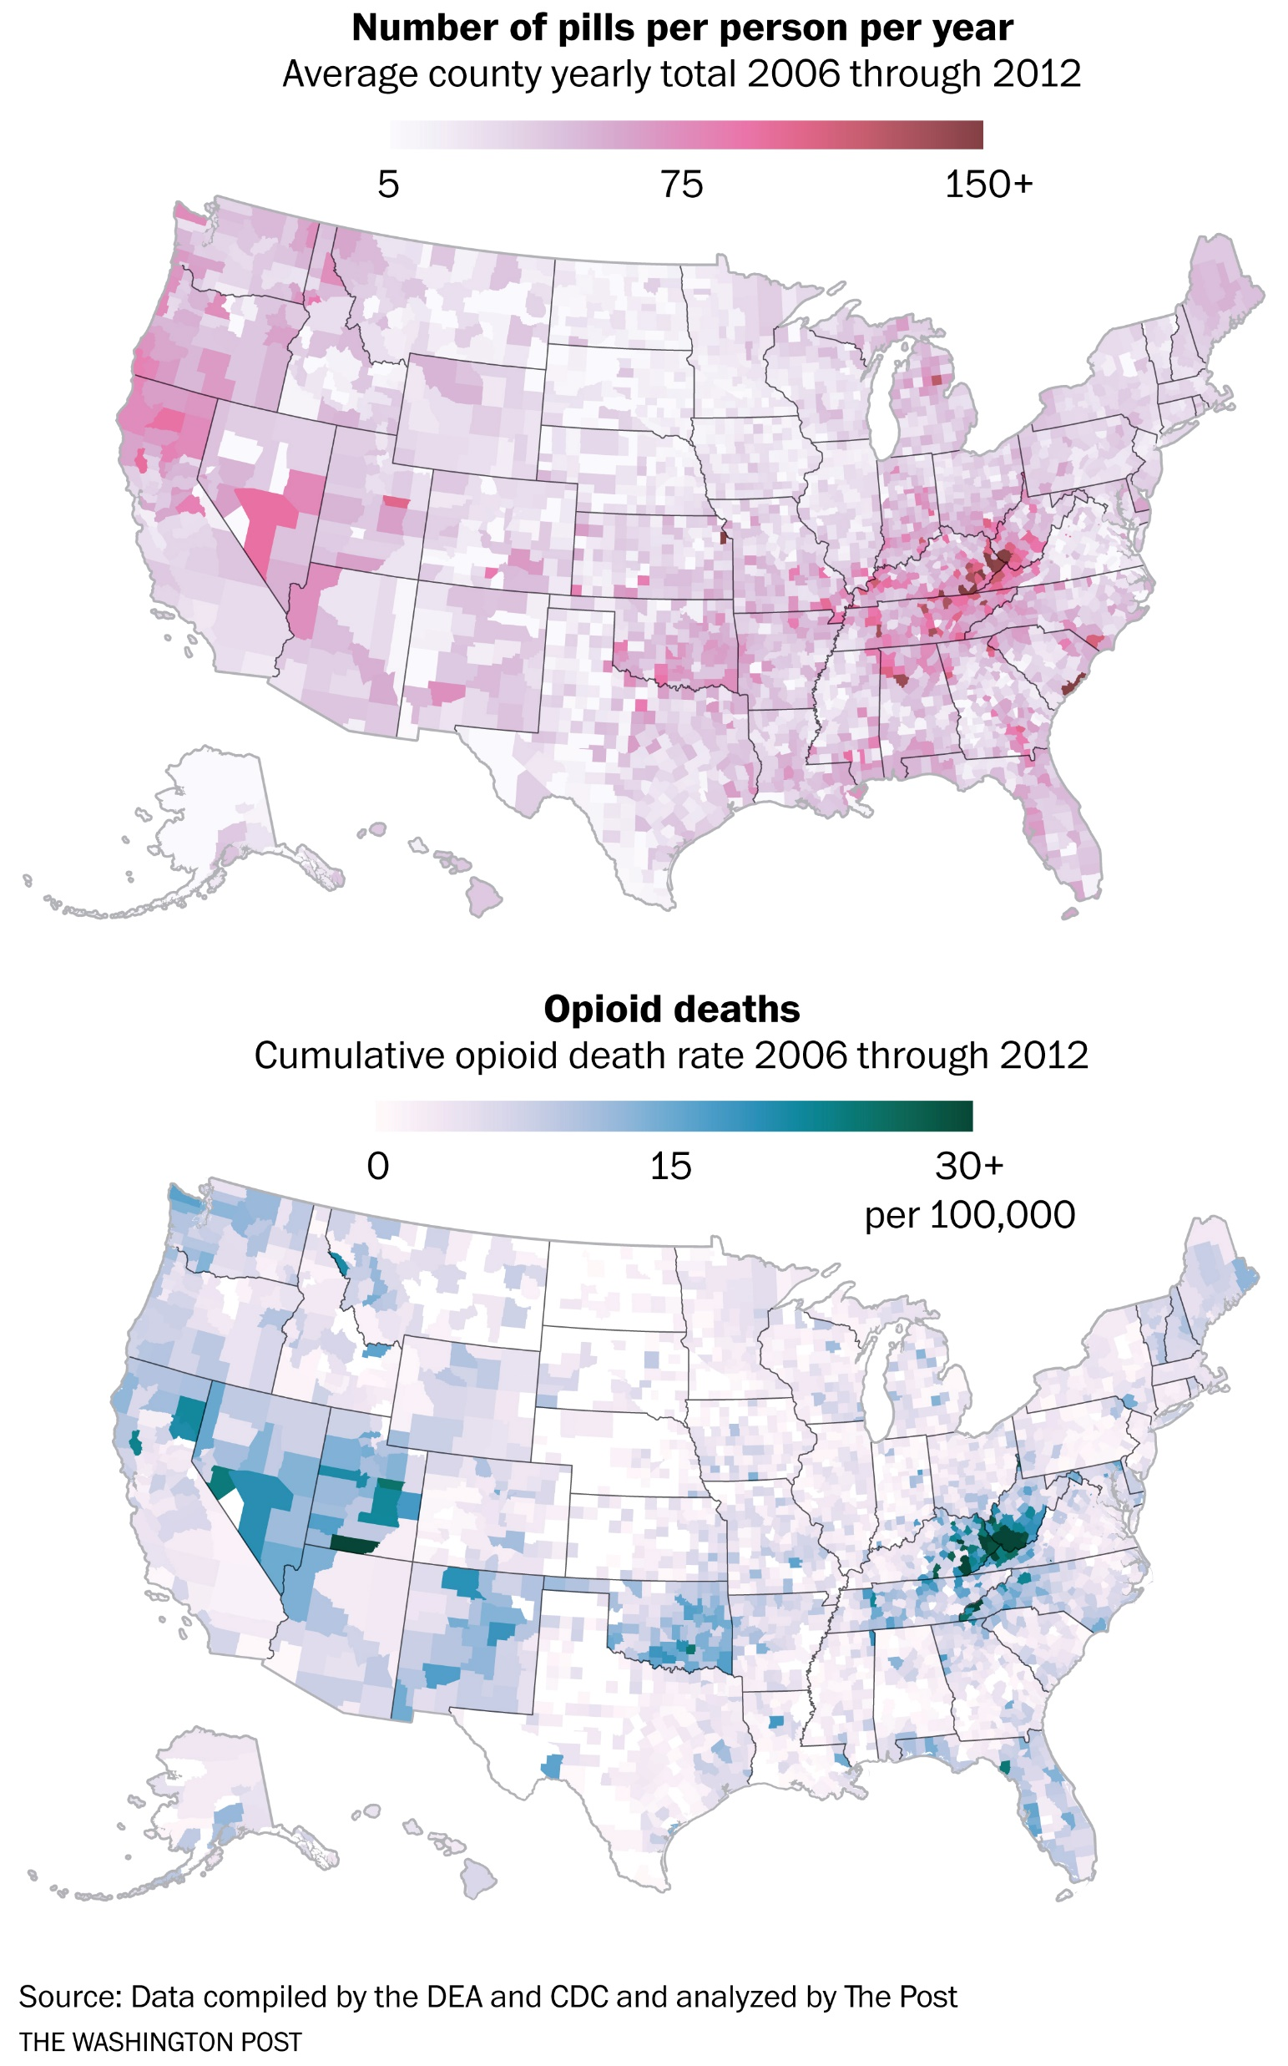
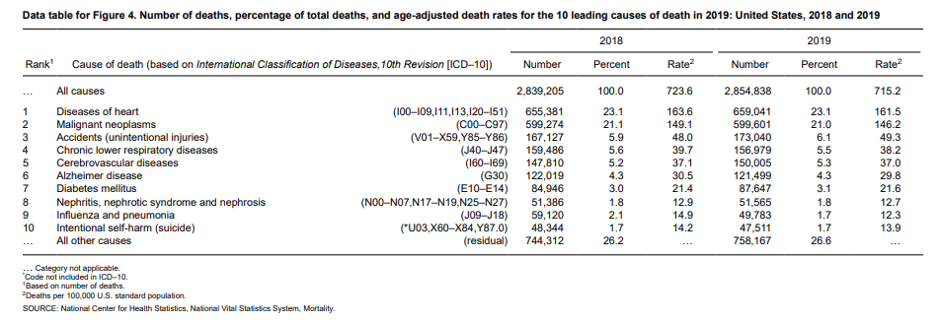
NCHS Data Brief, Number 395, December 2020
https://www.washingtonpost.com/graphics/2019/investigations/opioid-pills-overdose-analysis/

Slide 25
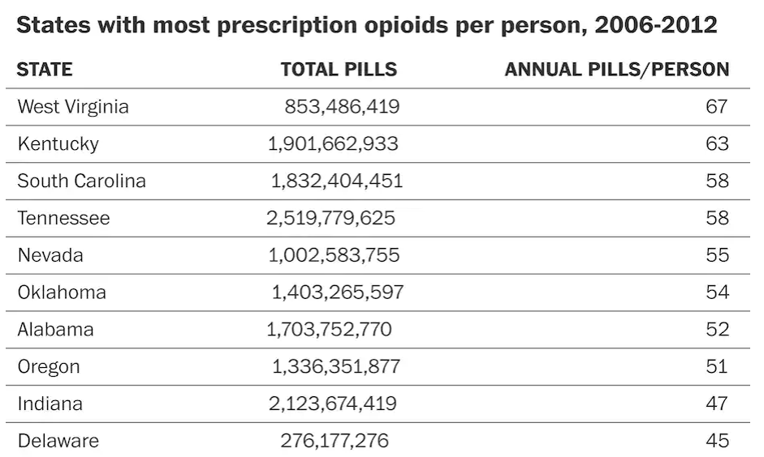
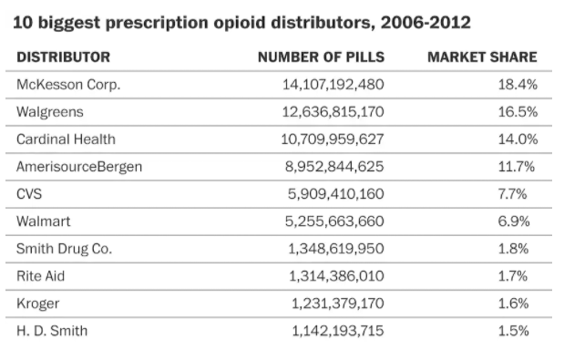
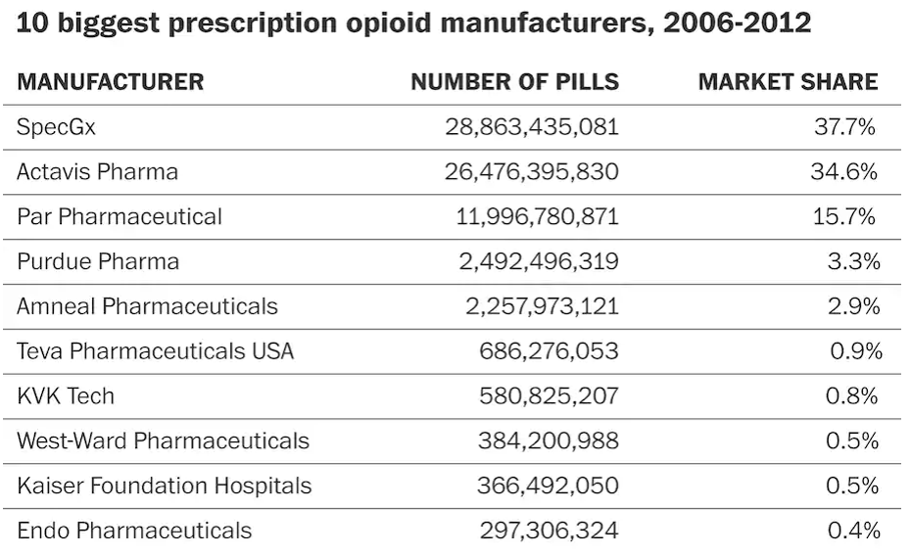
76 billion opioid pills: Newly released federal data unmasks the epidemic

Slide 26
Learn More
Alexander, M., Kusleika, R. and Walkenbach, J. Excel 2019 Bible. Wiley Press. 2018.
“The Information Master: Jean-Baptiste Colbert’s Secret State Intelligence System (Cultures Of Knowledge In The Early Modern World): Soll, Jacob: 9780472034642: Amazon.Com: Books.” https://www.amazon.com/dp/0472034642?ref=ppx_yo2ov_dt_b_fed_asin_title.

